Slide 1
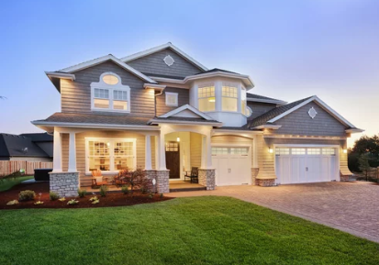
Predicting House Prices
Yog Chaudhary – Supervised Machine Learning Final ADTA 5340

Slide 2

CONTENTS
Dataset
Data Cleaning
Exploratory Data Analysis
Analysis ( Model Building and Training)
Conclusion

Slide 3

INTRODUCTION AND PROBLEMS STATEMENTS
The dataset was gathered from UNT: https://unt.instructure.com/courses/96279/files/22583650?module_item_id=5581585
The House Price Prediction problem is about estimating house prices using various factors and machine learning. It's a classic task for learning how to use and understand data in predicting real estate values. Key factors include local crime rates, land zoning, industrial proportion, number of rooms, and distance to work centers. This challenge helps in making smart decisions in real estate. It's a test for machine learning models to see how well they can predict prices based on these factors and use standards in learning data analysis and prediction techniques.
Publicly available dataset
House Price Prediction
Binary Classification

Slide 4
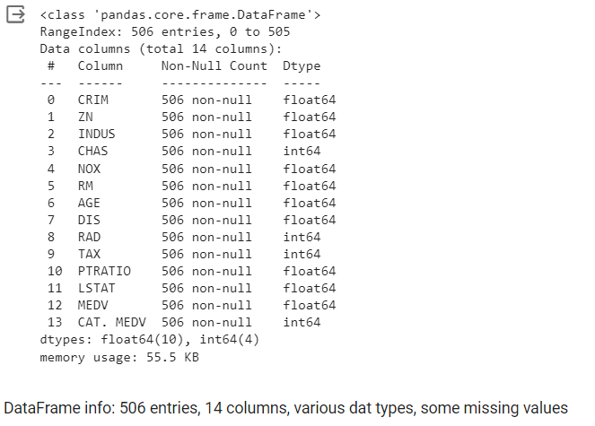
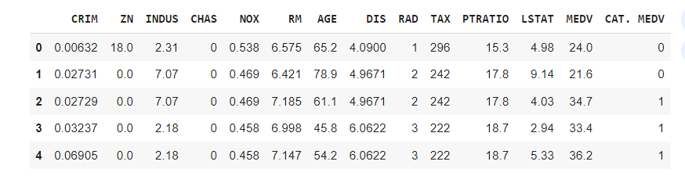
DATASET
14 Features and 506 Observations

Slide 5
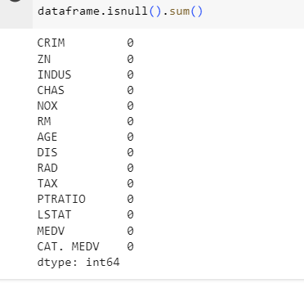


DATA CLEANING
Method
Remove and Handing Missing Values

Slide 6
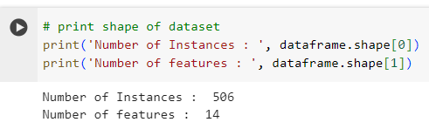
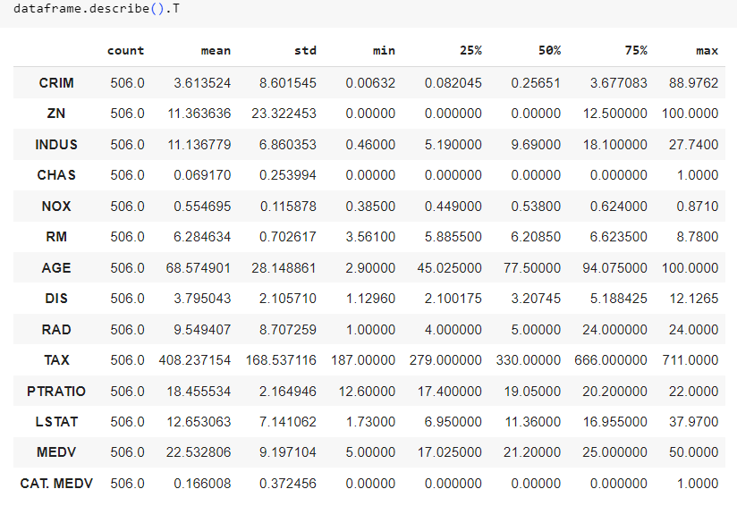
NEW FEATURE AND ATTRIBUTES
CRIM indicates variable crime rates.
ZN reveals the extent of residential zoning for large lots.
INDUS shows a mix of business acreage.
CHAS denotes proximity to the Charles River.
NOX provides air pollution levels.
RM reflects the average room count per dwelling.
AGE signifies the share of older homes.
DIS measures the distance to employment hubs.
RAD assesses access to highways.
TAX shows variability in property tax rates.
PTRATIO highlights student-to-teacher ratios.
LSTAT indicates the percentage of lower-income residents.
MEDV gives the median home values, and CAT. MEDV categorizes these values into a binary classification.

Slide 7
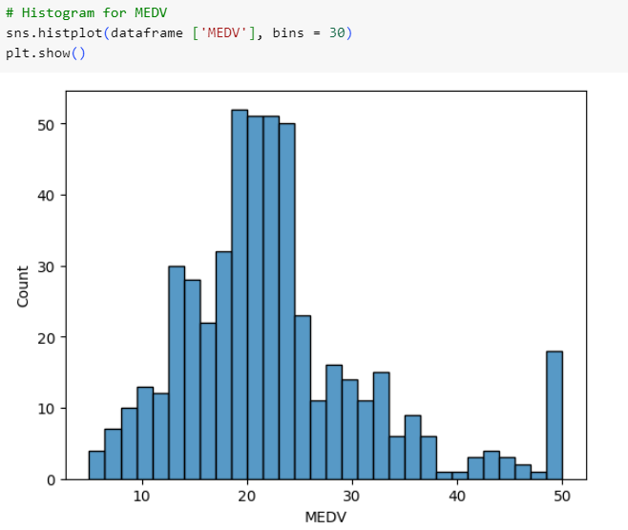
EXPLORATORY DATA ANALYSIS
The MEDV appears to have normal distribution without sked be proceed.

Slide 8

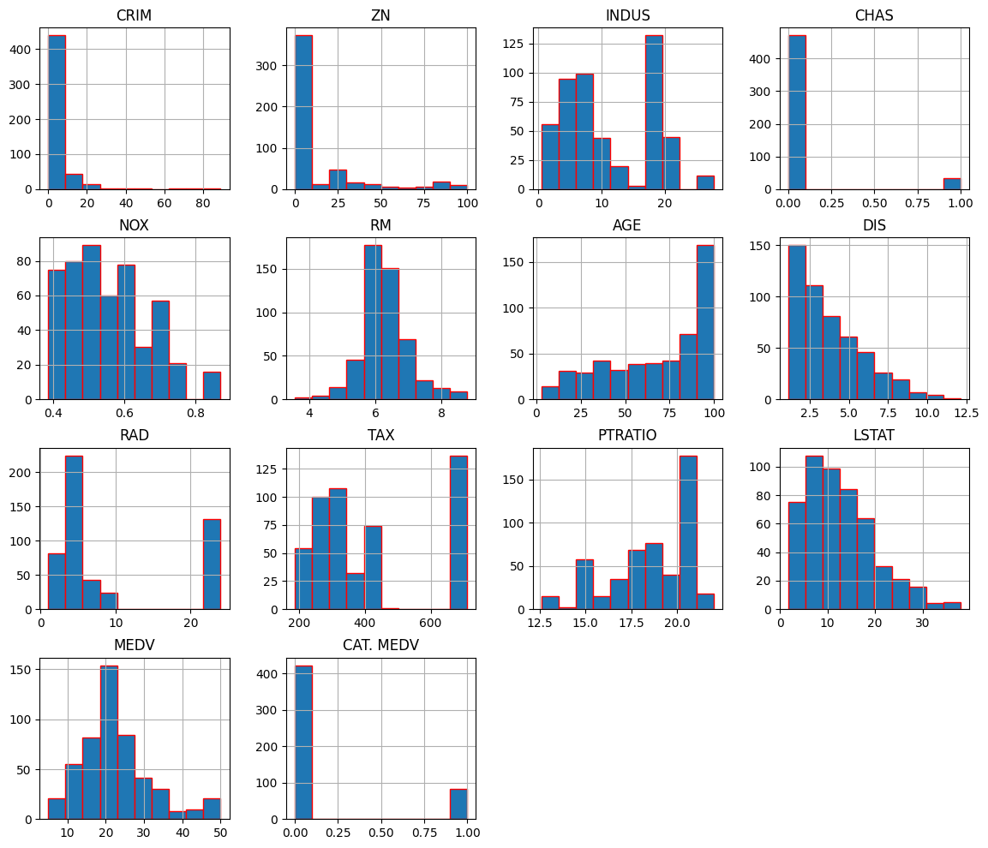
Histograms show the distribution of data points. CRIM, ZN, and LSTAT are skewed right, indicating a concentration of lower values with fewer high values.
RM appears normally distributed, suggesting most homes have a moderate number of rooms.
AGE and DIS indicate a range of old to new houses and varied proximity to employment centers.
TAX and RAD show clusters, indicating common tax rates and highway access levels.
CHAS, with most values at 0, suggests few properties are by the river.
MEDV shows house value distribution and
CAT. MEDV suggests most homes fall below a certain value threshold. These visualizations help in understanding the spread and concentration of data points across the variables.

Slide 9
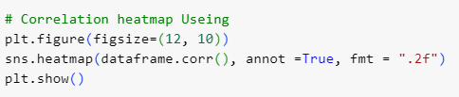
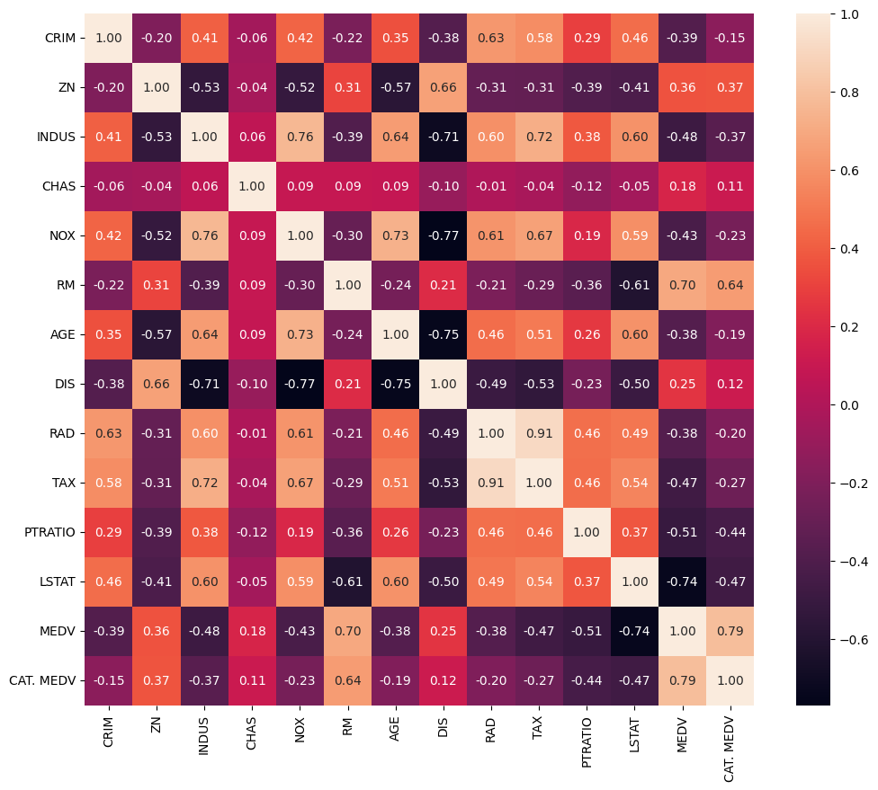
Bivariate Analysis – Correlation Matrix
Values close to 1 or -1 indicate a strong positive or negative correlation, respectively, while values near 0 show little to no linear relationship.
A high positive value between RAD and TAX suggests towns with more highways tend to have higher tax rates.
A high negative correlation between DIS and NOX implies that closer proximity to employment centers often coincides with lower air quality.
RM seems to have a higher positive correlation with MEDV and CAT. MEDV
LSTAT seems highly negatively correlated with MEDV and CAT. MEDV
CRIM, AGE, and RAD are also positively correlated with MEDV and CAT.MEDV seems to have a higher positive correlation with those independent variables compared to MEDV.
CRIM seems to have a positive correlation with RAD and TAX

Slide 10
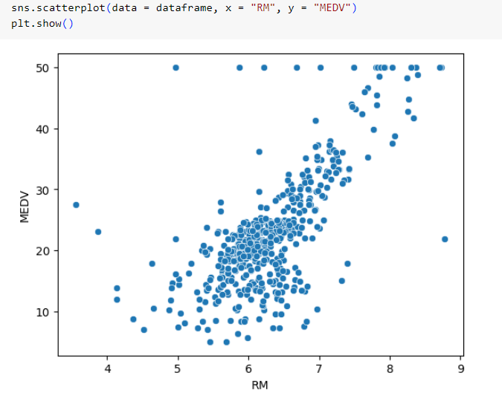
Scatter – Visualization
This price of the house compares the number of rooms in a house (RM) to the house's value (MEDV).
The trend indicates that as the number of rooms increases, the house's price generally increases, which is expected since larger houses tend to cost more.
The plot also highlights outliers. specifically, there is a horizontal line of points where the MEDV value is capped at 50, suggesting a maximum limit set.

Slide 11


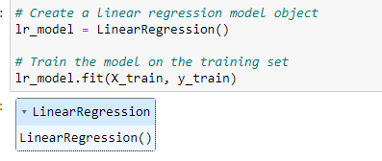
MODEL BUILDING AND TRAINING
The dataset is divided into input and output NumPy arrays in the fourth stage.
The target variable (MEDV) is the only variable present in the output array (y), whereas all other variables are present in the input array (X)

Slide 12
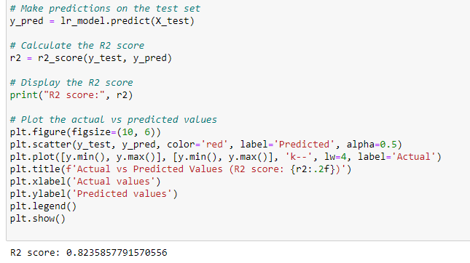
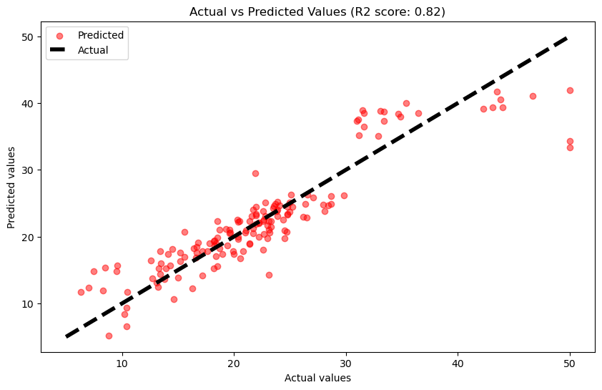
MAKING PREDICTING AND R2 VALUES
The value R-squared (R2) is a statistic that measures the portion of the outcome variation explained by the model's inputs. An R2 of 1 means perfect prediction, 0 means the model predicts no better than the average outcome, and a negative R2 indicates the model performs worse than just using the average. It helps to assess the model's accuracy in predicting data.
The value R-squared (R2) score of 0.82, the model has a high level of predictive accuracy, it’s indicating less accuracy in the predictions for those values.

Slide 13
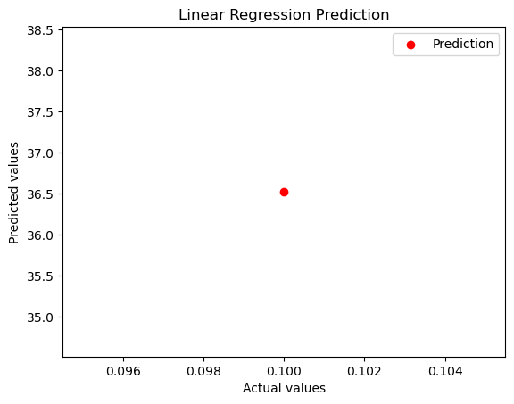
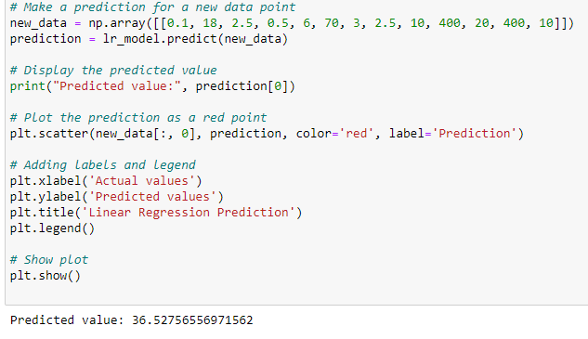
MAKING PREDICTIONS AND EVALUATING OWNER-OCCUPIED HOME
Since, the new data Median values of the owner-
Fare predicted values of our model.

Slide 14
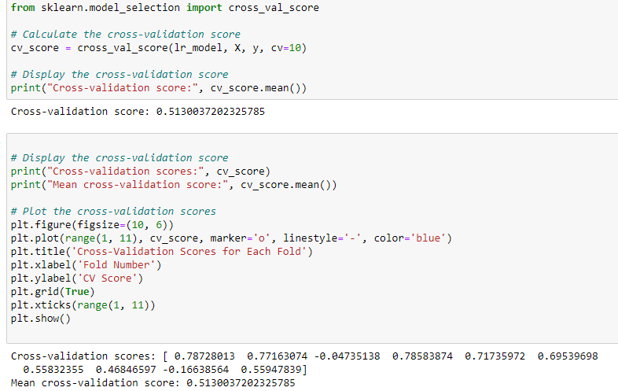
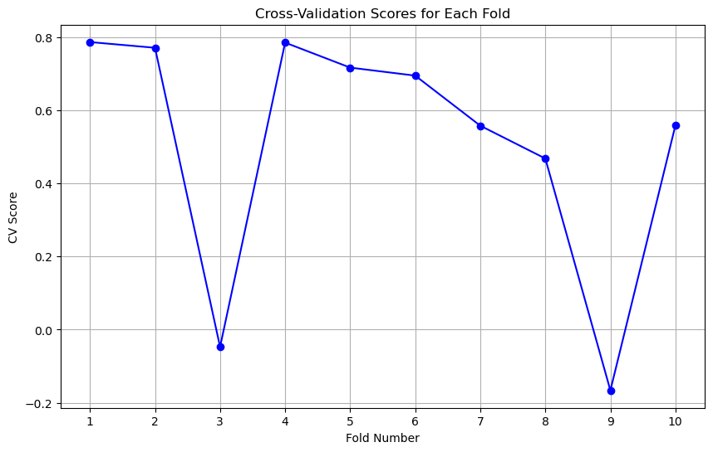
EVALUATE 10 –FOLD CROSS-VALIDATION
The model will be assessed using 10-fold cross-validation in the last stage. The code computes the cross-validation score, which Most scores are positive, indicating good predictions, but variations, including a negative score, suggest the model's performance can fluctuate depending on the data subset it's trained on. Its Value or score – 0.5130.
Using the cross_val_score () function from Scikit-Learn. The user sees the overall cross-validation score. It shows different values.

Slide 15
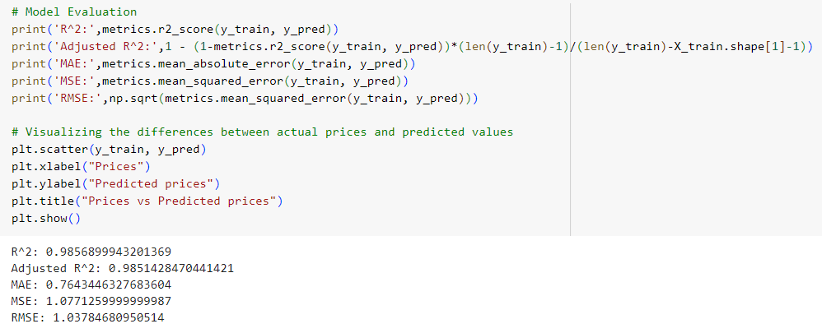
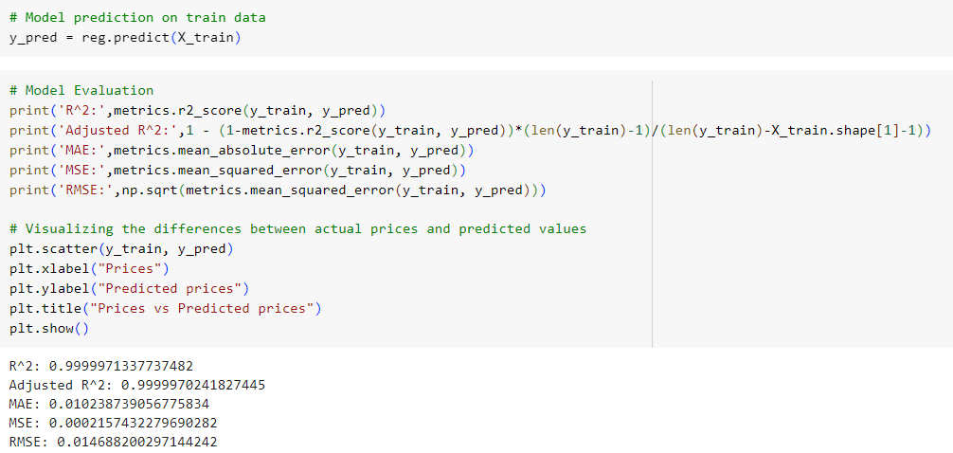
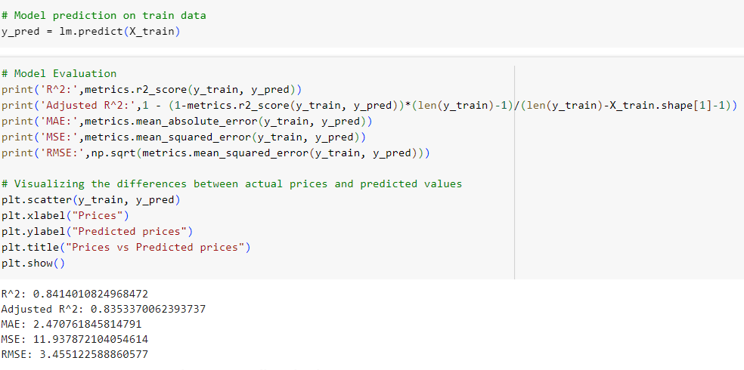
Ethical Build and Train Model Regression
Linear Regression
Random Forest
XGBoost
SVM

Slide 16
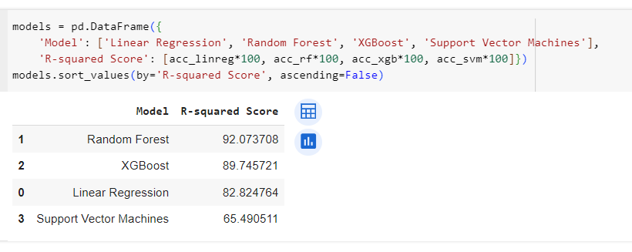
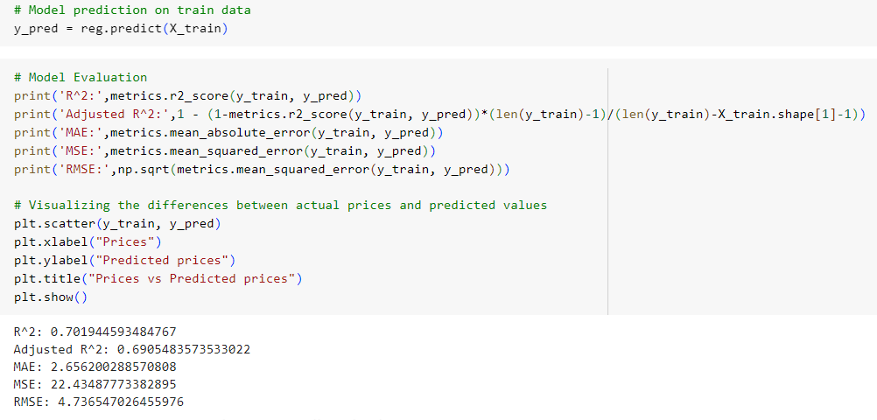
Models Evaluation and Comparison

Slide 17
CONCLUSION
We used supervised machine learning to predict house prices. Our first model's accuracy score, R2, was 0.8235, which is pretty good.
Then we improved our model with new data, and the R2 went up to 36.5275, but this number is likely a mistake because R2 should be between 0 and 1.
We also checked our model with a method called 10-fold cross-validation. This means we tested the model 10 times with different parts of the data to make sure it works well with new information.
The average score from these tests tells us if our model is reliable

Slide 18
REFERENCES
Nivitus 12, 2020 Boston House pricing Prediction Using Machine Learning, Link: https://medium.com/analytics-vidhya/boston-house-price-prediction-using-machine-learning-ad3750a866cd
https://www.kaggle.com/code/shreayan98c/boston-house-price-prediction
Scikit-Learn developers. The ames housing dataset. 2022. URL: https://inria.github.io/scikit-learn-mooc/python_scripts/datasets_ames_housing.html.
Michael Tipping. The relevance vector machine. Advances in neural information processing systems, 1999. URL: https://proceedings.neurips.cc/paper/1999/file/f3144cefe89a60d6a1afaf7859c5076b-Paper.pdf.

Slide 19

Yog Chaudhary

